Slide 1


SOFTWARE REQUIREMENT SPECIFICATIONS
FOR ONLINE SHOPPING SYSTEM

Slide 2
Meet Our Team
61
Namra Mevada
2A IT
22002170110049
62
Ekalkumar Sorathiya
2A CE
22002170110028
63
Bhavya Patel
2A CE
22002170110106
70
Yasvi Vaghasiya
2A CE
22002170110199
81
Chirag Patel
2A CE
22002170110107

Slide 3
INTRODUCTION :
These Report is about giving an brief and detailed information about the our project ONLINE SHOPPING SYSTEM.
Document is divided into some few main category in which there are also few sub categories.
These Categories and sub categories will give us detailed requirements and mandatory assessment about our project.
SRS know as Software Requirement Specification is the Part of the any project which provide us the Bridge between Company and Client.
In SRS document we will make sure that all the clients needs and requirements are covered and make a document according to that.
It will be the description of the system that what it will provide, how it will perform and What will it takes to work.
Project manager or In charge of project generally makes these report after having communication of needs and exceptation with client for whom they are creating these system.

Slide 4
Main Category
Introduction
Overall Description
System Feature
External Interface Requirement
Other Non Functional Requirement
Other Requirements(Optional)

Slide 5
INTRODUCTION
Purpose
MAIN AGENDA
Document Convection
BRIEF ABOUT SRS
Project Scope
VISION
Intended Audience
FOR WHOM

Slide 6
Overall Description
Product Feature
Product Perspective
USE CASE DIAGRAM
USER CLASSES AND CHARACTERITICS
Operating Enviroment
FOR SELLER BUYER AND OWNER
Design and Implementation Constraints
Providing Documents
Assumption and Dependencies
Here Windows 11
User
Documentation

Slide 7
System Feature
Description of Feature
Priority of Feature
Stimulus/Response Sequences
Functional Requirement
Flow Of feature
System Feature 1
System Feature 2
System Feature 3
And so on..

Slide 8
External Interface
Interfaces
User Interface
Seller Interface
Sales Manager Interface
Account manager Interface
Purchase manager Interface
Customer Care Interface
Administrator
Interface
Communication Interface
Hardware
Interface
Software Interface

Slide 9
Other Non Functional Requirement
Performance Requirement
Security Requirement
Software Quality Attributes
Safety Requirement

Slide 10
Use case Diagram
Login
Manage Customer Database
Browse
Category
View/Delete Guest Book Entries
Add/Remove item from cart
Add/Remove/Update item Category
Payment
Administrator
Approve/Reject Shop
Cash
User
Shipping Order
Giving Feedback
Log Out
Visit Page
View Account Details
Create new Account
Cancel Order

Slide 11
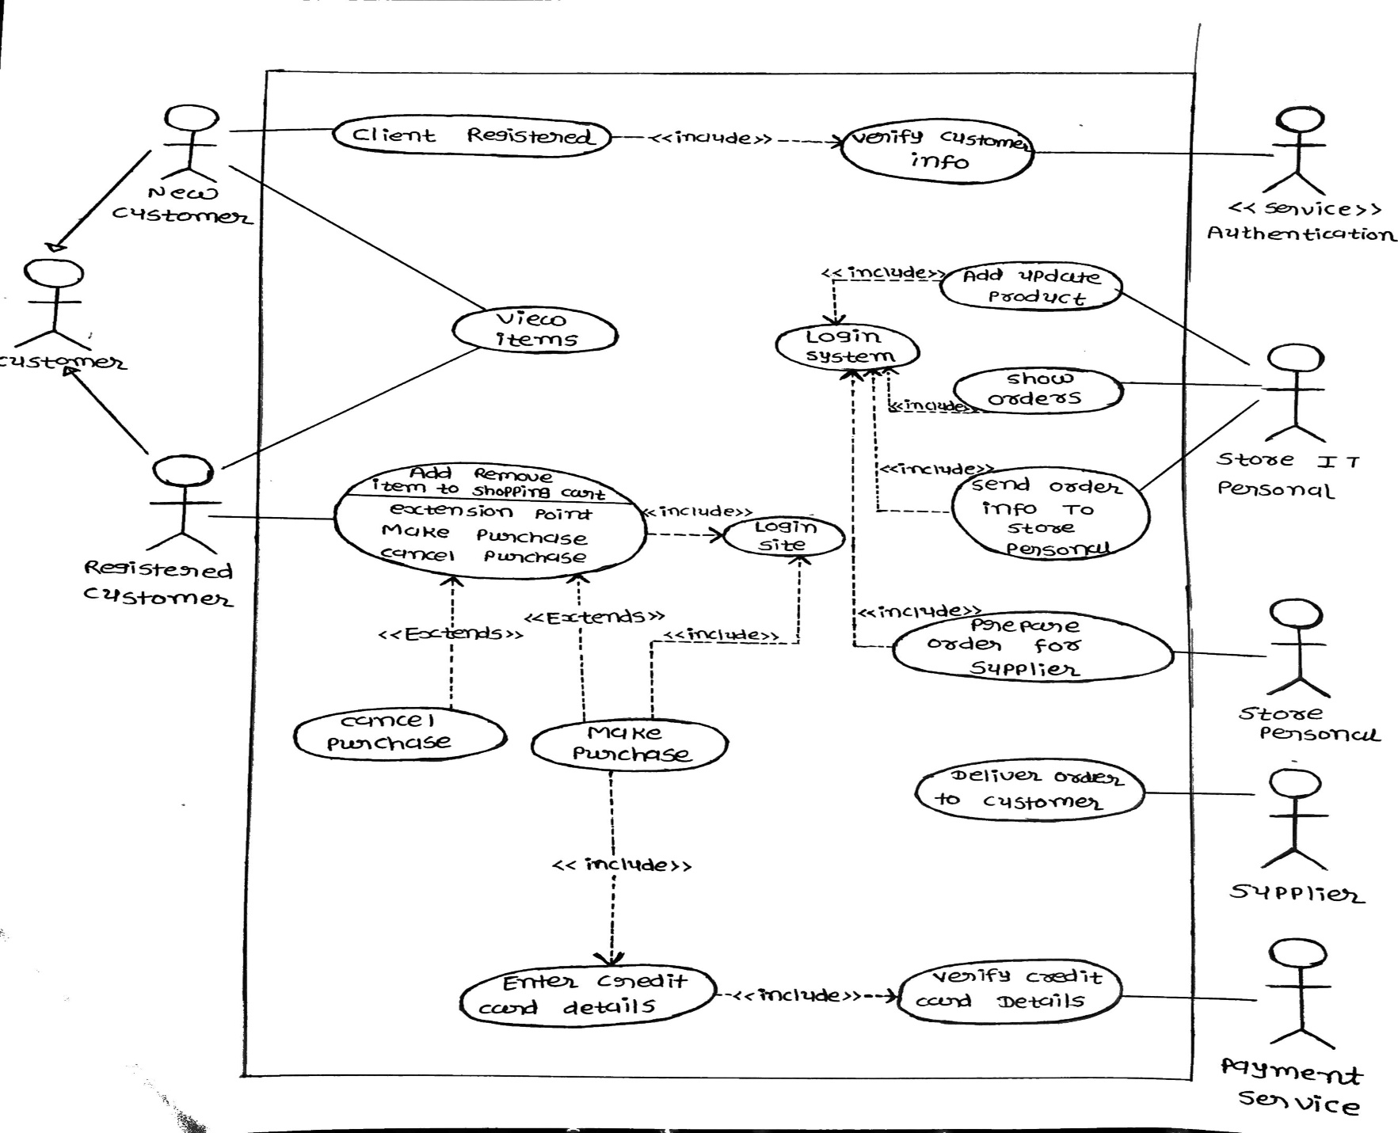
USE CASE DIAGRAM OF SYSTEM FEATURE

Slide 12
LEVEL 0 DFD
ADMINISTRATOR
BILL DETAILS
ONLINE SHOPPING SYSTEM
ORDER CONFORMATION
ADMINISTRATOR
CHANGE/UPDATE PRODUCT LIST
PRODUCT LIST
CUSTOMER
BILL DETAILS
PAYMENT
CUSTOMER

Slide 13
LEVEL 1 DFD
ADMINISTRATOR
CUSTOMER
ADMINISTRATOR
PAYMENT
PAYMENT DETAILS
CHANGE/UPDATE PRODUCT LIST
SELECT ITEM
VIEW LIST
SELECTED ITEM DETAILS
ORDER CONFORMATION
BILL DETAILS
PAYMENT
CUSTOMER
CHECKOUT
ITEM DETAILS
BILL DETAILS
BILL DETAILS
ADMINISTRATOR

Slide 14
THANK YOU

